Slide 1
TideBox
(Humber in a Box 2)
Unreal Engine 4 Real-time Lisflood Simulation
Notes:
We are the tidebox team; Sam, Robby and Adam. There will be a time for questions at the end so if you have a comment that is the time to do so.

Slide 2
Introduction
Project Overview
Unreal Engine 4, C++, Blueprints
Designed and developed for a client in the University of Hull Geography Department
Allows for Lisflood hydrodynamic model simulation of the Humber and the surrounding area
Project History
2014/2015 - Unity
2015/2016 - N/A
2016/2017 - Unreal Engine
2017/2018 - Unreal Engine
Project Future
Hosted at geological conventions
Future potential installation at The Deep

Slide 3
Use of Scrum/Agile Practices
Daily Stand-up Meetings
Regular Client Communication
Product Backlog Refinement
Monthly Sprint Cycles
Sprint Planning
Planning Poker
Sprint Reviews
Sprint Retrospectives
Pair Programming
Incremental Release Schedule
Notes:
Throughout the project we followed the agile methodology. More specifically we stuck to SCRUM, this involved:
Daily stand up meetings to track progress

Slide 4
Video Demonstration
A short demonstration of the Lisflood Hydrodynamic Model
Notes:
Here is a quick video demonstrating the simulation.
This first scene showing an exaggerated water to show the water flow.
This next scene is showing the realistic water heights. The terrain has been multiplied as the Humber is a flat area. The water is read in through the tide data file. Currently there are some missing data in the data files we were produced so the water appears to be breaking through the flood defences but this can be fixed easily in the future.

Slide 5
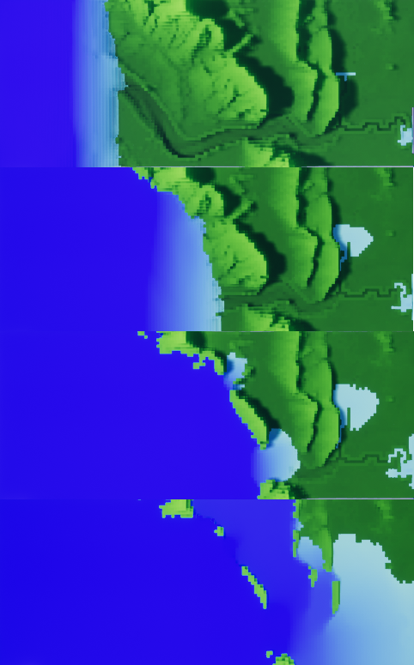
Lisflood Illustration
1
3
2
4

Slide 6
Work Contributed
Flexible data parser/data conversion tool
Simplified procedural mesh generation (terrain and water)
Added Lisflood hydrodynamic model simulation to water mesh
Codebase reduction and simplification
Colour of materials dependent on Z height for better visualization of water flow
Interactable simulation triggers and in-world visual feedback (UI)
General graphical improvements made to the scene
Notes:
We created a data parser to format the data for use in our Unreal project. Different data formats were needed for the separate three different input files; tidal input, terrain data and river inputs. The parser is capable of converting multiple files simultaneously.
Added a procedural mesh for the water which dynamically changes based on a simplified version of the Lisflood algorithm.
Reduced and improved almost the entire code base. There was a lot of over complex, unnecessary or even redundant code which we removed or rewrote. The code base is less than half while improving the functionality.
Restructured how procedural meshes are created and handled for added simplicity. We changed the style to a blocky minecraft style as the client mentioned that children like that.
Added height based materials which add a gradient to the simulation for an improved visual aesthetic.
We added an in world UI with buttons for the user to press and a screen which provides feedback and information.
Added the ability to render the procedural meshes as voxels in alignment with the client’s preferences and improved performance.
Added ray cast based in world button press as the client asked for a natural interaction with the simulation; without a glaring GUI over the screen.

Slide 7
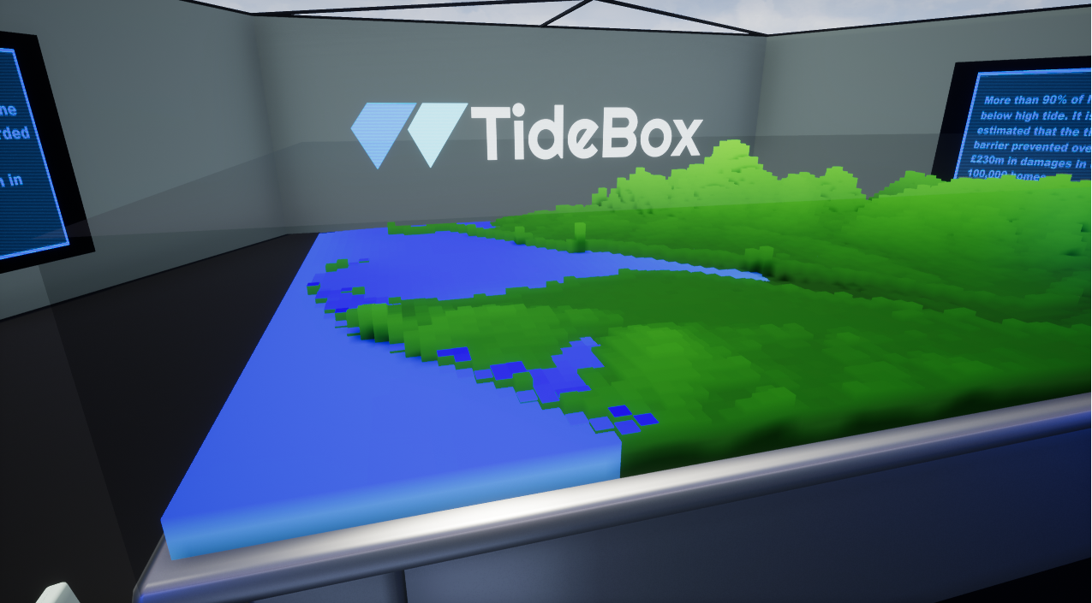
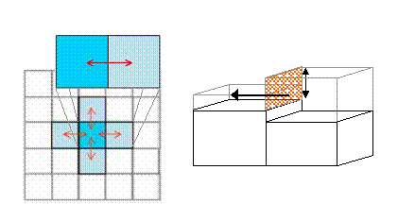
Lisflood Hydrodynamic Model
Client’s main requirement and the core focus of our project
Pair programming utilised to enhance quality
Accurately follows a simplified version of the Lisflood hydrodynamic model
http://www.bristol.ac.uk/geography/research/hydrology/models/lisflood

Slide 8
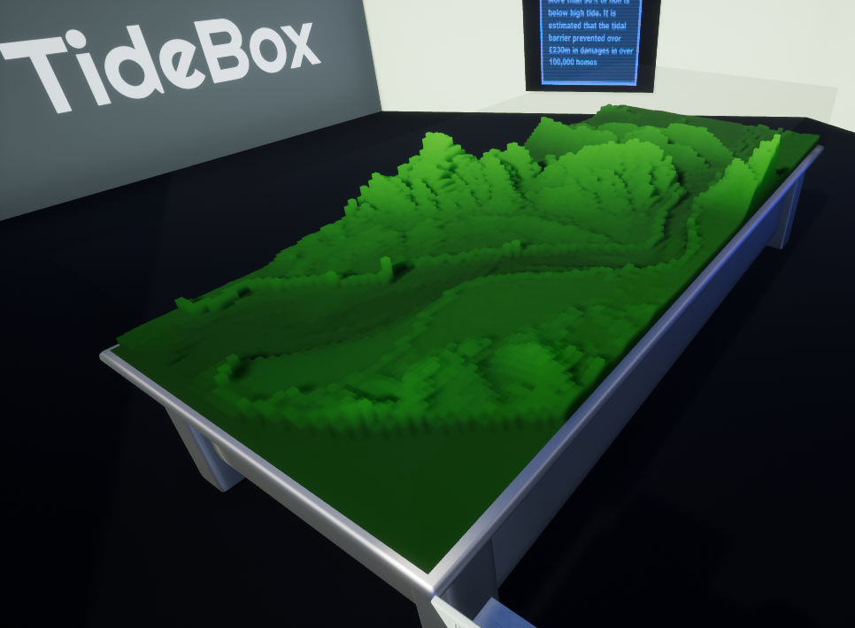

Procedural Mesh Generation
Rewrote how procedural meshes were created and handled
Changed the mesh rendering style to fit the client’s preferences and needs
Now stands as a much truer representation of the data provided (same resolution)
Scalable and reliable

Slide 9
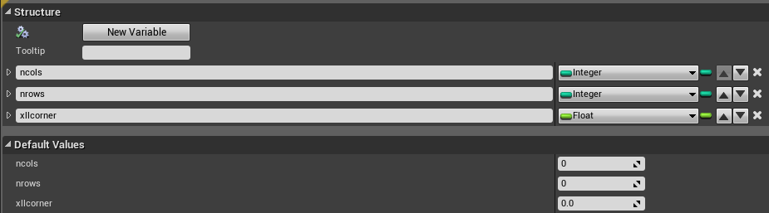
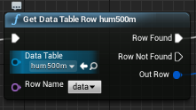
Data Handling
Current data files are for the tidal height, river inputs and the terrain
Created a file parser to port the data files provided by the client (.txt) into a format which can be easily read into Unreal Engine (.csv)
Created Blueprint structures in alignment with the client’s data format
Easily switch out data files through Blueprints
Could be extended to handle more data formats easily
Tested multiple data sets

Slide 10
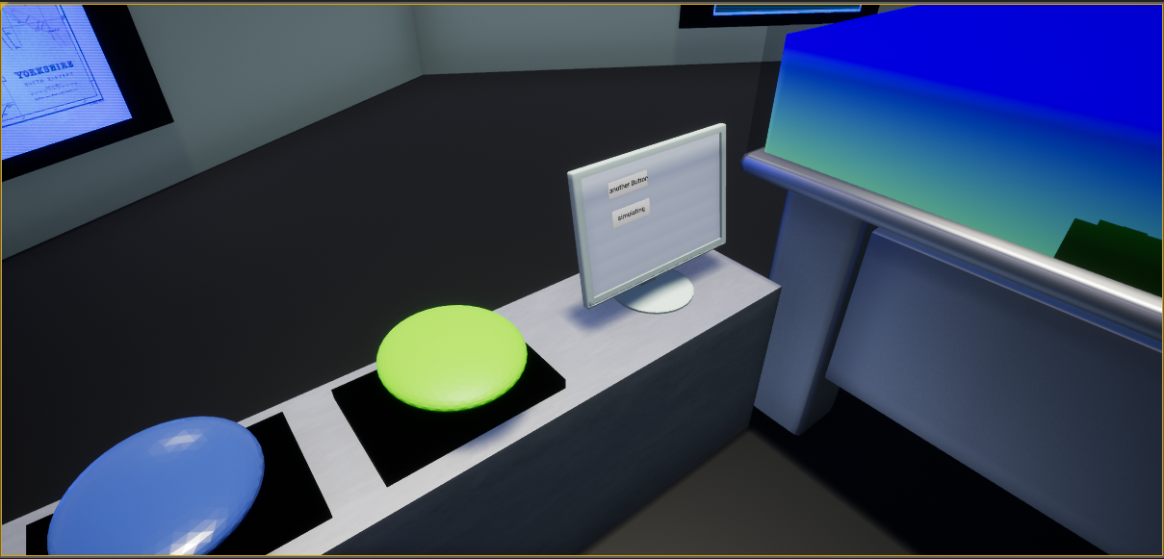
GUI and Controls
Client requested a GUI that was “grounded in reality”
Controls mapped to the Xbox 360 controller
Buttons are interactable using a raycasting method
Notes:
I suggested to the client to add buttons and an interactable screen for the GUI to make the application more accessible. Client asked for GUI grounded in reality. (so no floating text) after discussion with the client, we agreed that it would be better to be facing the table and press the button to increase user engagement. Controls updated to include the XBox 360 controller as per the clients needs. GUI increases user engagement as the user now has to physically start and stop the flood. One of the failures was that the raycast works by returning the name of the object hit and executing the code according to the name which is unstable if the names of the object change for whatever reason. This was done as a last minute addition as i couldnt figure out how to use the data from a level blueprint in a blueprint class

Slide 11
Successes and Failures
Successes
Water flow implemented using Lisflood
Reduction in procedural mesh complexity yields improved performance and faster load times
Created a flexible and extensible data input and handling system
GUI effectively increases user engagement with the application
Well adapted to client’s needs
Failures
Our Lisflood implementation is a simplified version
Sprint Task time estimation was inaccurate at the start of the project
GUI does not display flood information to the screen fully
Issues with importing data in .exe build

Slide 12
Future Steps
VR Integration
Oculus Rift
Potentially HTC Vive and other devices
Scenarios
Utilising different data sets to create different experiences
Improve the visual feedback provided to the user about the simulation
Audio guide walkthrough
Miscellaneous simulation information

Slide 13
Thank you for your attention
Questions?

